Slide 1

Domain: MATLAB
Technology: COMMUNICATION
DOA ESTIMATION FOR WIDEBAND LFM SIGNALS
WITH A FEW SNAPSHOTS

Slide 2
Index
Abstract
Introduction
Literature review
Existing Method
Disadvantages
Proposed method
Advantages
Applications
Hardware and Software Requirements
Results
Conclusion
References

Slide 3
Abstract
The wideband linear frequency modulation (LFM) signals are widely used in information systems. The conventional direction-of arrival (DOA) estimation algorithms of LFM signals rely on a large number of snapshots, some of which are not reliable in numerous practical applications such as underwater array processing. To solve the above problem, we present a modified sparse iterative covariance (MSPICE)-based estimation method in fractional Fourier transform (FrFT) domain to estimate the DOA of wideband LFM signals. First, we extend the original SPICE algorithm in FrFT domain with a specific transform order for wideband LFM signals. Then, we utilize the energy centrobaric modification method to make the original SPICE more accurate without adding more computational complexity. The simulation results demonstrate the effectiveness of the proposed method..

Slide 4
Introduction:
DOA estimation arises an important problem in a number of fields including sonar, radar, and wireless communication in recent years . The classical delay-andsum (DAS) method suffers from low resolution and high sidelobe levels, while the well-known multiple signal classification (MUSIC) method, which requires a large amount of snapshots, provides super-resolution DOA estimation for narrowband uncorrelated signals . Furthermore, the wideband LFM signal, which is an important class of non-stationary signals, has been widely used in the abovementioned information systems. So many DOA estimation approaches have been proposed for them, such as MUSIC method in FrFT domain , Estimating signal parameters via rotational invariance techniques (ESPRIT) in FrFT domain and ambiguityfunction- based techniques , etc. However, none of these methods is able to provide high-angular resolution depending on very low snapshots which is the case when the environment being sensed by the array is stationary for a short duration of time.

Slide 5
Cont…
A FrFT-MSPICE method is proposed to estimate the DOA for wideband LFM signals using a few snapshots based on the modified SPICE algorithm and FrFT. First, wideband LFM signal was represented as a sine wave with a single frequency in FrFT domain, so that the time-invariant steering vector can be obtained for the original SPICE algorithm. Then, we improve the original SPICE for higher accuracy and utilize it to estimate the DOA values in FrFT domain. The accuracy of the SPICE depends on the number of scanning points in the region, but increasing this number for higher accuracy will also dramatically increase the computationalcomplexity. So, we utilize the energy centrobaric modification method to improve the accuracy of SPICE without adding too much computational cost.

Slide 6
Literature review:
S. NO | Journal Type with year | Authors | Title | Outcomes
1 | Ad Hoc Netw. (2016). http://dx.doi.org/10.1016/j. adhoc.2016.04.005 | X Liu, Z Li, P Yang et al., | Information-centric mobile ad hoc networks and content routing: a survey. | Studied abouttime-frequency analysis method with array process algorithm
2 | Springer Singapore· 2018 | Deliang Liu,Xiwei Guo,Peng He,Shen Zhao | DOA Estimation for Wideband Chirp Signals | Studied about the Fractional Fourier Transform (FrFT)
3 | IEEE Trans. Signal Process. 54(5), 1826–1839 (2006) | N Ma, JT Goh, | Ambiguity-function-based techniques to estimate DOA of broadband chirp signals. | Studied about incoherent broadband chirp DOA estimation
4 | IEEE Trans. Signal Process. 59(1), 35–46 (2011) | P Stoica, P Babu, J Li, | “New method of sparse parameter estimation in separable models and its use for spectral analysis of irregularly sampled data. | Studied about The SPICE (semiparametric/sparse iterative covariancebased estimation) method
5 | in Proc. IEEE OCEANS (Sydney, 2010), pp. 1–10. | Z Chen, J Li, P Stoica, KW Lo: | Iterative adaptive approach for wide-band active sonar array processing. | Studied about studied about the superior performance of IAA over the CBF

Slide 7
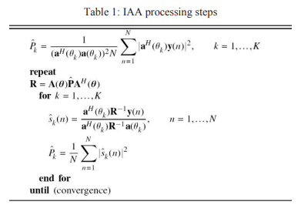
Existing method:
IAA (Iterative Adaptive Approach (IAA) is a nonparametric adaptive algorithm recently proposed for array processing applications.The Iterative Adaptive Approach is a spectral estimation technique that is based on a weighted least squares minimization. The method was originally proposed for source localization, but has found other applications in imaging, pulse compression, and missing data estimation .

Slide 8

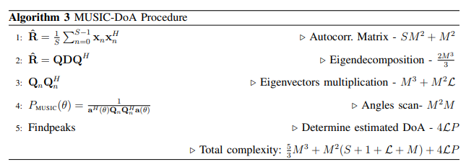
Cont..
MUSIC ALGORITHM (MUltiple SIgnal Classification algorithm)
The MUSIC algorithm is another classic DOA estimation technique with high resolution. Its output is
where Un is the noise subspace spanned by P eigen-vectors corresponding to noise components, Unlike the MVDR algorithm ,the MUSIC algorithm does not require N>=2M signal snapshots to estimate the spatial covariance matrix R. The number of snapshots N just needs to be equal to or larger than the number of signal sources (M-P).

Slide 9
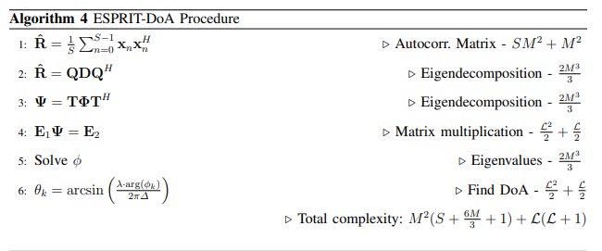
Cont..
Conventional ESPRIT Method: The ESPRIT operates under an array of antennas with M elements, divided into sensor doublets. Each sensor is distant d from its respective pair and each doublet is distant ∆ from one another. The doublets can be separated to form 2 sub arrays with m elements in each. The distance d may be different from ∆, which makes it quite dynamic in cases of non-uniform arrays. However, the most commonly used antenna arrays possess sensors uniformly spaced.

Slide 10
Disadvantages in Existing methods:
1.More time to estimate DOA: MUSIC algorithm need for a larger angle range for peak search, coupled with the complexity of the time-frequency transform, it takes a long time to get the DOA estimation of the incoming wave signals. MUSIC also has the problem of large computational capacity.,requires large amount of snapshots,
2.Accuracy is not Good: The estimation accuracy of ESPRIT algorithm, is not so good
3.Computational Complexity:MUSIC also has the problem of large computational capacity
4.These methods is not able to provide high-angular resolution depending on very low snapshots..

Slide 11
Proposed method:
In this paper, a FrFT-MSPICE method is proposed to estimate the DOA for wideband LFM signals using a few snapshots based on the modified SPICE algorithm and FrFT. First, wideband LFM signal was represented as a sine wave with a single frequency in FrFT domain, so that the time-invariant steering vector can be obtained for the original SPICE algorithm. Then, we improve the original SPICE for higher accuracy and utilize it to estimate the DOA values in FrFT domain. The accuracy of the SPICE depends on the number of scanning points in the region, but increasing this number for higher accuracy will also dramatically increase the computational complexity. So, we utilize the energy centrobaric modification method to improve the accuracy of SPICE without adding too much computational cost

Slide 12
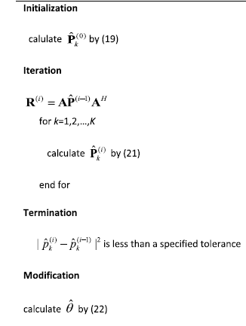
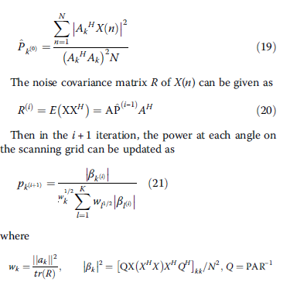

Algorithm of proposed method

Slide 13
Advantages of Proposed method:
Estimate the DOA for wideband LFM signals using a few snapshots
Provide high-angular resolution.
Accuracy is good.
Low complexity

Slide 14
Applications:
Information systems.
underwater array processing.
sonar, radar, and wireless communication.

Slide 15
Hardware and Software Requirements:
Hardware & Software Requirements:
Software: Matlab R2018a.
Hardware:
Operating Systems:
• Windows 10
• Windows 7 Service Pack 1
• Windows Server 2019
• Windows Server 2016
Processors:
Minimum: Any Intel or AMD x86-64 processor
Recommended: Any Intel or AMD x86-64 processor with four logical cores and AVX2 instruction set support
Disk:
Minimum: 2.9 GB of HDD space for MATLAB only, 5-8 GB for a typical installation
Recommended: An SSD is recommended a full installation of all Math Works products may take up to 29 GB of disk space
RAM:
Minimum: 4 GB
Recommended: 8 GB

Slide 16
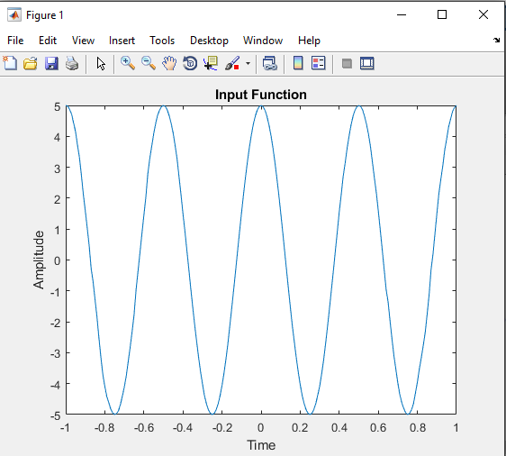
Results and Discussions:
Figure:Input Function

Slide 17
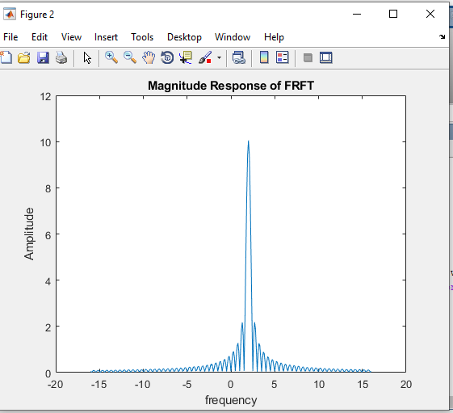
Results and Discussions:
Figure: Magnitude Response of FRFT

Slide 18
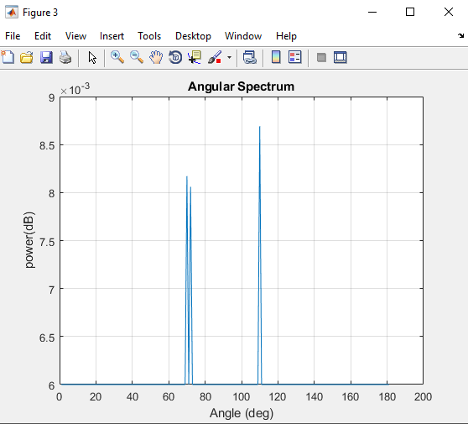
Results and Discussions:
Figure:Angular Spectrum

Slide 19
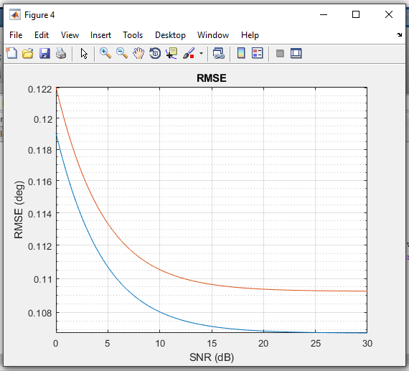
Results and Discussions:
Figure :RMSE

Slide 20
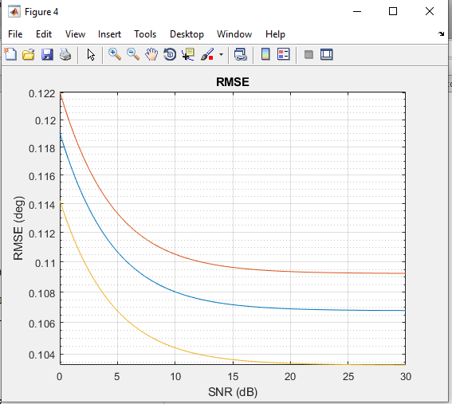
Modified code

Slide 21
CONCLUSION:
We presented a FrFT-MSPICE method for the DOA estimation of wideband LFM signal. We extend the SPICE algorithm in FrFT domain so that the DOA of wideband LFM signals can be estimated with a few snapshots. The proposed method has high angular resolution and low sidelobe levels. We also utilize the energy centrobaric modification method in order to increase the accuracy of the SPICE algorithm without imposing too much additional computational burden. The simulation results have demonstrated the effectiveness of the proposed method..

Slide 22
References:
[1] X Liu, Z Li, P Yang et al., Information-centric mobile ad hoc networks and content routing: a survey. Ad Hoc Netw. (2016). http://dx.doi.org/10.1016/j.adhoc.2016.04.005.
[2] Deliang Liu,Xiwei Guo,Peng He,Shen Zhao
[3] N Ma, JT Goh, Ambiguity-function-based techniques to estimate DOA of broadband chirp signals. IEEE Trans. Signal Process. 54(5), 1826–1839 (2006)
[4] P Stoica, P Babu, J Li, New method of sparse parameter estimation in separable models and its use for spectral analysis of irregularly sampled data. IEEE Trans. Signal Process. 59(1), 35–46 (2011)
[5] Z Chen, J Li, P Stoica, KW Lo, Iterative adaptive approach for wide-band active sonar array processing. in Proc. IEEE OCEANS (Sydney, 2010), pp. 1–10

Slide 23
FAQS(for student reference)
Steering matrix: The steering matrix is a precise mathematical description of how the antenna array should use each individual element to select a spatial path for the transmission
Why we go for the ULA (uniform linear array)?:
By using the single antenna for DOA estimation, beam width of the primary lobe get more extensive and appropriate resolution is not acquired, I f we attempt to expand the resolution, physical size of antenna is also increased yet it is not a practical approach. To overcome this issue , ULA is considered for DOA estimation. ULA is an array comprise of equally spaced antenna of generally same amplitude therefore antenna array is more effective over the single antenna in signal reception and parameter estimation.
Direction of Arrival (DOA) algorithms are used for estimation of a number of incident plane waves on the antenna array and their incidence angles.
Direction-of-arrival (DOA) estimation refers to the process of retrieving the direction information of several electromagnetic waves/sources from the outputs of a number of receiving antennas that form a sensor array.
In signal processing, direction of arrival (DOA) denotes the direction from which usually a propagating wave arrives at a point, where usually a set of sensors are located. These set of sensors forms what is called a sensor array. Often there is the associated technique of beamforming which is estimating the signal from a given direction
A sensor array is a group of sensors, usually deployed in a certain geometry pattern, used for collecting and processing electromagnetic or acoustic signals
Fundamental parameters of linear frequency modulation (LFM) signals, i.e., the initial frequency and Chirp rate
Snapshots are no of samples in TD which aids in DOA estimation.

Slide 24
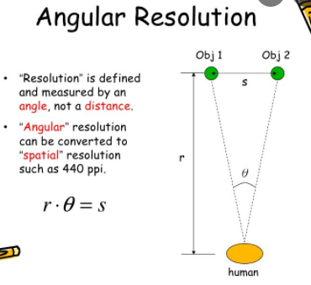
T HE resolution of a beamformer represents its capability to separate two incoming plane waves arriving at different angles accurately, thus assessing how well sources can be distinguished.
Angular resolution refers to the ability to see objects that are close together.
Covariance talks about the direction of the relationship between the two variables.
Red line is SPICE Algorithm
blue line is MSpice algorithm
Yellow line is the modification done by varying element_positions parameter in linear array.(as said by you sir to vary any parameter),I think its better to say extension of Mspice algorithm ,sir its just my suggestion.

